Slide 1


Exploring ESG Sentiment and Financial Performance
Group: Codeconomics
Yuanhan Cui
Yu Hui Zhicheng You Jiale Zhou

Slide 2
Content
01 Introduction
02 Data Collection
03 Sentimental Analysis
04 Regression & Visualization

Slide 3

01
INTRODUCTION

Slide 4

RESEARCH BACKGROUND
“For company, ESG content is easy to be manipulated”
Lack of Standardization: There's a significant lack of standardization in how ESG data is collected, reported, and assessed. Different organizations and frameworks may prioritize different metrics, making it difficult to compare ESG performance across companies or industries consistently. This lack of uniformity can lead to manipulation, as companies might choose to report selectively, emphasizing metrics that portray them in a favorable light while omitting or de-emphasizing less favorable information.
Subjectivity in Metrics: Many ESG metrics involve a degree of subjectivity. For instance, while environmental metrics like carbon emissions can be quantified, social metrics like labor practices or governance issues such as board diversity often involve qualitative judgments. This subjectivity can introduce biases and allow for the manipulation of data to present a more positive ESG profile.
Q: Do firm have incentive to manipulate the tone of ESG disclosure to conceal its bad financial performance (profitability, risk)?
Notes:
These questions are significant because they delve into whether ESG disclosures serve as genuine indicators of corporate health or are used by companies to mask underlying issues. By exploring the impact of ESG sentiments on financial performance and investor confidence, this research contributes to understanding the real value of ESG disclosures in the financial domain.

Slide 5

RESEARCH QUESTION
How does overall sentiment within ESG disclosures correlate with financial performance?
Does sentiment within each ESG component (Environmental, Social, Governance) correlate with financial performance?
Does investor confidence/concern mediate the relationship between ESG sentiment and financial performance?
Notes:
These questions are significant because they delve into whether ESG disclosures serve as genuine indicators of corporate health or are used by companies to mask underlying issues. By exploring the impact of ESG sentiments on financial performance and investor confidence, this research contributes to understanding the real value of ESG disclosures in the financial domain.

Slide 6
SOCIAL SCIENCE RELEVANCE
UNDERSTANDING CORPORATE INFLUENCE
ANALYZING INVESTOR BEHAVIOR
INFORMING POLICY AND REGULATION
Provides insights into how corporations communicate their roles and responsibilities in economic, environmental, and social spheres through ESG disclosures.
Offers a deeper understanding of corporate behavior, shedding light on alignment with societal values and norms.
Examines how investors incorporate ESG information into their decision-making processes, influencing market dynamics.
Highlights the evolving nature of investment strategies, reflecting changing societal attitudes towards sustainability and governance.
Offers empirical evidence to guide policy discussions on transparency, accountability, and sustainability in the corporate sector.
Contributes to the development of effective regulatory frameworks, promoting responsible corporate practices and market integrity.
Notes:
Three entities: corporate/investor/regulator
Provide insights for these three entities and is conducive to a healthy financial system

Slide 7
02
Data Collection

Slide 8





Data Source
Direct filtered and download financial performance indicator data (ROE and Solvency ratio that characterize the profitability and risk performance of the company) from Orbis database: https://login.bvdinfo.com/R1/Orbis;
Scrapped ESG content used for sentiment analysis from financial report：EDGAR filing - 10K annual financial report: https://www.sec.gov/edgar/searchedgar/companysearch
Time period：2023

Slide 9
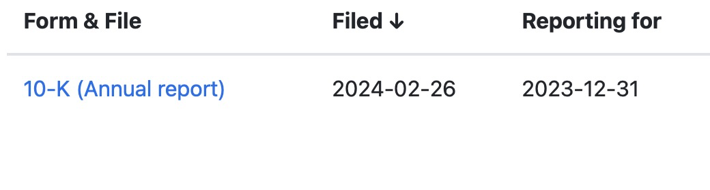
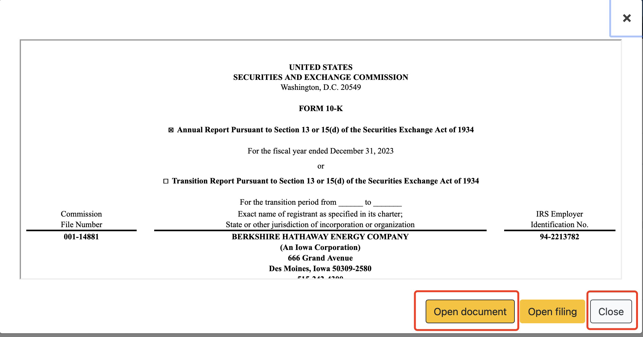
Data collection process : dynamic scrapping
Scrap dynamically: We need to click on certain buttons before reach the report we aim to scrape .
1. preview button
2. popped up preview
3. wait it to load
4.click open button
5. click close button for preview window
6. click on next page (if we have already scrapped all the report urls in current page, and stop if there is no next page available.)
selenium
Notes:
The main difficulties is related to data scrapping. Although the financial report in Edgar websites is in html format, which is scrapable, to access the financial report we need to click on certain buttons. For each report, firstly we need to click on preview button, then in the popped up preview page we need wait it to load and click open button. Also, we need to click close button for preview and click on next page if we have already scrapped all the report in current page, and stop if there is no next page available. Thus we need to scrap dynamically. That is why we use selenium to scrape. Our formal step is firstly scrap all the urls of preview button for each report, then we click on each preview button, get the url link for each open file button, and close the preview window. Here is a short video of scrapping using selenium.

Slide 10
Data collection process : soup and retrieve ESG content
Use request and beautiful soup to collect and soup report content
Check if there is any words related to ESG in each sentence of financial report(We have built an ESG word dictionary that helps us to screen the words )
If there is, we store this sentence to our ESG content dictionary for each company.
For data in Obris, we collected financial data of 10529 companies in the US as of 2023 (we added filter conditions including public limited companies, with size classifications as very large, and are still active in the market).
For ESG content in Edgar, we finally collected data from 8517 companies that release financial reports last year.
Notes:
Finally, we get a list of urls for each companies’financial report. We use request and beatiful soup package access and soup each page content for each url, and check if there is any words related to esg in each sentence of financial report. (We have build a esg word dictionary that helps us to screen the words ).If it is, we store this sentence to our esg content dictionary for each company.

Slide 11
Data cleaning and wrangling
Remove rows that contains NA values in financial metrics data
Data cleaning and matching
Matching data: CIK number as identifier
Process esg string data by by removing punctuation, special characters, and stopwords
Notes:
we try to collect data from both resources and match them. There is also a difficulty with matching the data from orbis to data from edgar. We want a unique and distinct company identifier to match the data from two source. Fortunately, we find the CIK number in both database. The CIK number also helps us in identifying the buttons for scrapping, as each company’s button have the CIK number under certain class that made us easy to identify button for each company.
After matching two dataset, we get 1249 companies data. We then remove the na values in the financial metrics data and process esg string data by by removing punctuation, special characters, and stopwords. and get 1153 companies data of financial metrics and esg content.

Slide 12
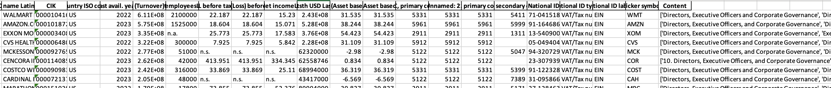
Final Output
1153 company’s data of financial metrics (ROE and Solvency ratio as profitability and risk indicator, total asset as control variable) and corresponding cleaned ESG content.
Notes:
we try to collect data from both resources and match them. There is also a difficulty with matching the data from orbis to data from edgar. We want a unique and distinct company identifier to match the data from two source. Fortunately, we find the CIK number in both database. The CIK number also helps us in identifying the buttons for scrapping, as each company’s button have the CIK number under certain class that made us easy to identify button for each company.
After matching two dataset, we get 1249 companies data. We then remove the na values in the financial metrics data and process esg string data by by removing punctuation, special characters, and stopwords. and get 1153 companies data of financial metrics and esg content.

Slide 13
03
Sentimental Analysis

Slide 14
Data Analysis - Overview
Sentiment Analysis
Regression
A set of four regression equations
respectively to investigate potential mechanism
Get the sentiment score
for the regression equation.

Slide 15
Sentimental Analysis
Sentiment Analysis
A supervised training model was employed. The implementation methodology can be broken down into the following key steps:
1. Employ the positive and negative words dictionary (LM dictionary).
2. Build the ESG dictionaries (one for each category: environmental, social, governance).
3. Count the total number of words that are positive and negative. By subtracting the number of negative words from the number of positive words, derive the total "points" for the given ESG category.
5. For each file, derive the total ESG points by aggregating the total points for each ESG category.
6. Normalization for Cross-File Comparison: we normalizes the total points by the total number of sentiment words within each document to convert the score into a percentage

Slide 16

1. Sentiment Word Lists
Objective
Read-in the positive words list and negative words list.
In order to train the model to recognize 'positive' and 'negative' sentiments, the Loughran-McDonald Master Dictionary with Sentiment Word Lists data set was used.

Slide 17
1. Sentiment Word Lists (a sample)
Positive
Negative
advantages
diligently
enhancement
innovator
positively
creative
lucrative
collaboration
aberrant
disruption
malfunction
omission
prosecute
severity
undermine
wrongdoing

Slide 18
2. Building ESG Dictionaries
Objective and Application:
Creates specific dictionaries to identify ESG-related discussions within annual reports
They will be used to detect and analyze ESG-related discussions in corporate documents
Process Overview:
Preparation: Construct seed lists for ESG keywords.
Dictionary Construction: Use word embeddings (Word2Vec) to find words semantically similar to a seed list of known ESG keywords and filter them to expand our list with related ESG terms.

Slide 19
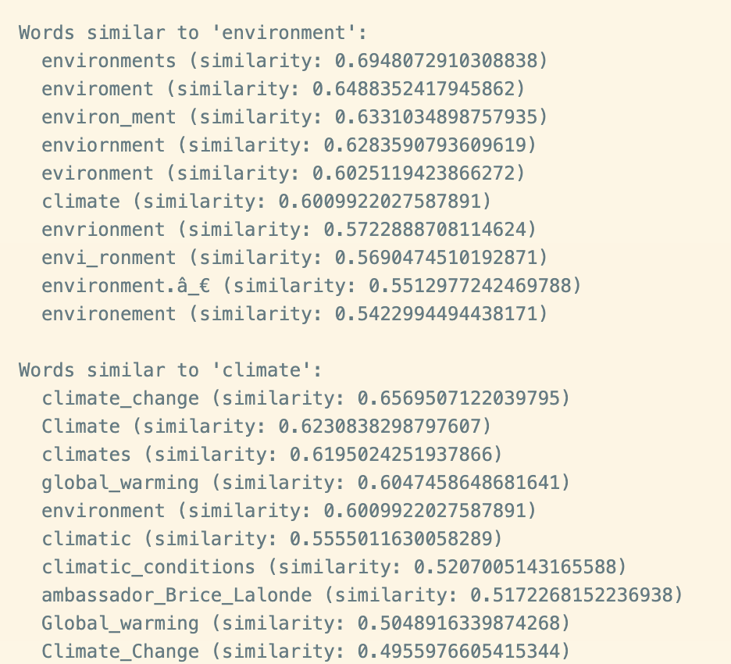
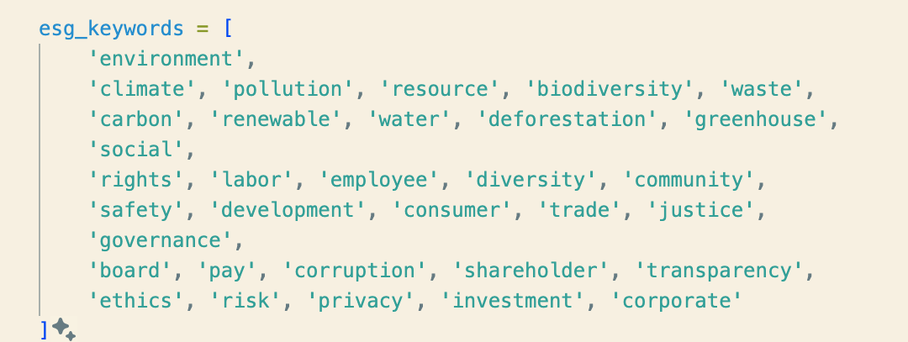
2. Building ESG Dictionaries
Output(sample):
Example:
Seed list:

Slide 20
4. Quantifying Discussions and Calculating Points
Step 1: Positive and Negative Word Counts
We count how many words are positively/negatively associated with ESG topics.
This involves our predefined lists of positive and negative word lists tailored to the context of ESG discussions.
Step 2: (In each ESG Category) Derivation of Total Points for E, S, and G
We calculate a "total points" score for Environmental, Social, and Governance discussions separately.
Total Score = Positive Score - Negative Score
This score reflects the overall sentiment or stance of the document toward each ESG category.
Step 3: Normalization for Cross-File Comparison:
Since the documents may vary significantly in their volume of ESG discussions, we normalizes the total points by the total number of sentiment words to convert the score into a percentage.
This normalization allows for a fair comparison across documents of different lengths and densities of ESG discussions.

Slide 21
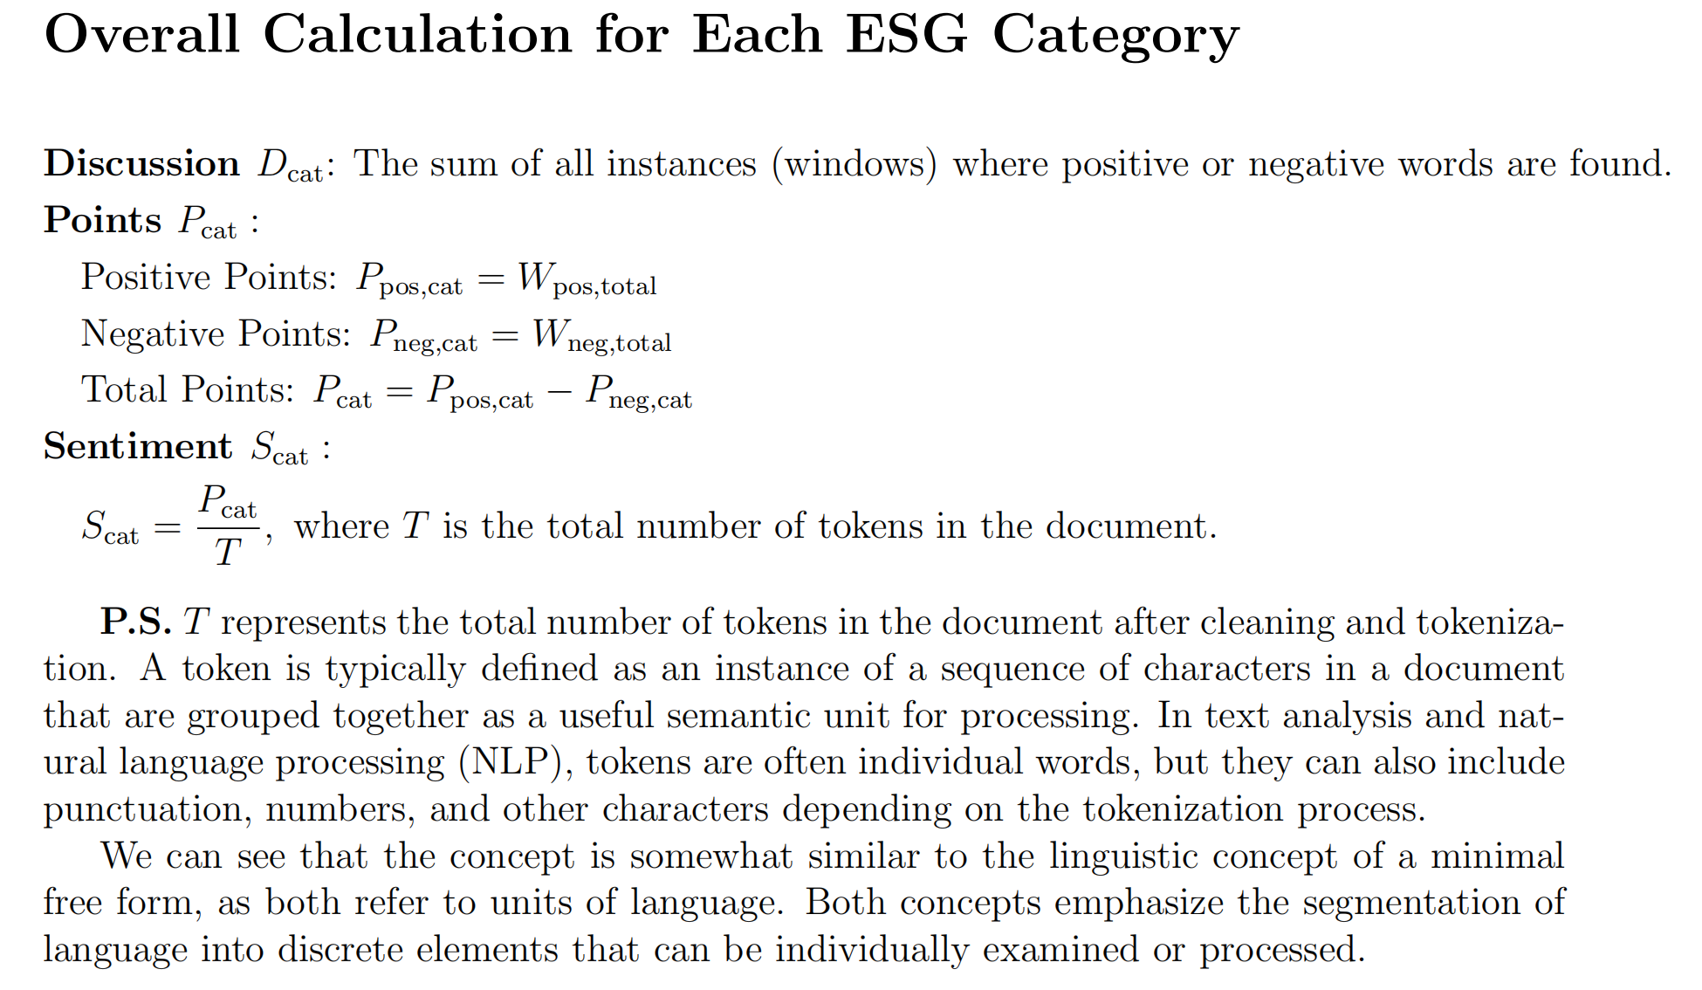
4. Quantifying Discussions and Calculating Points

Slide 22
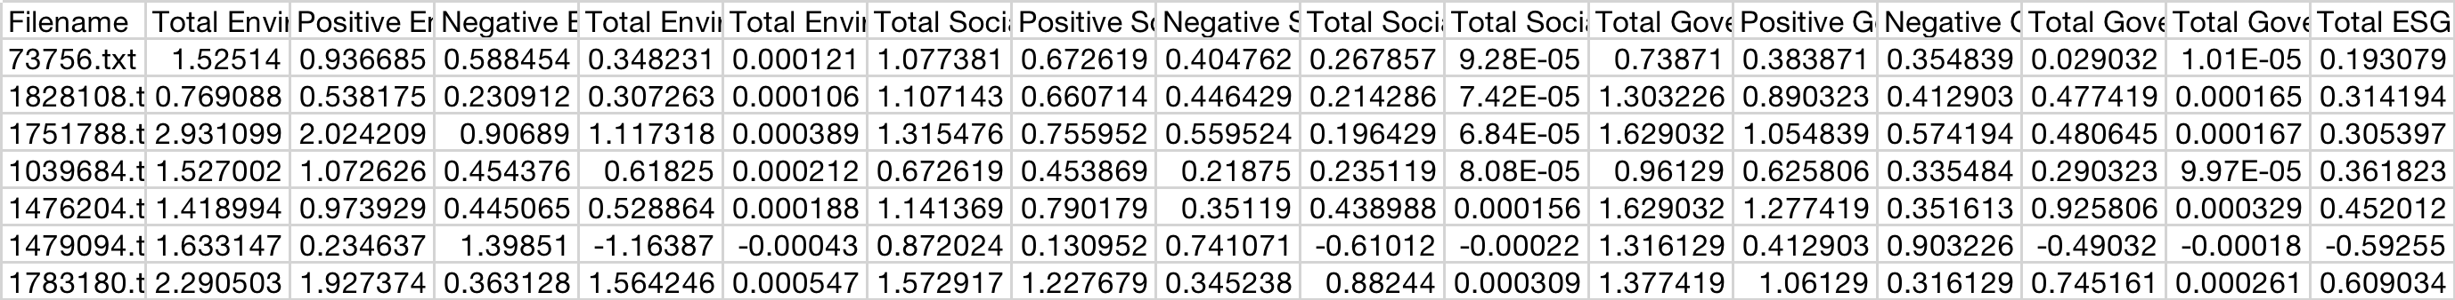
Output
Output Variables
Total Environmental/Social/Governmental Discussion
Total E/S/G Points
Positive E/S/G Points
Negative E/S/G Points
Total E/S/G Sentiment
Total ESG Sentiment

Slide 23
04
Regression & Visualization

Slide 24
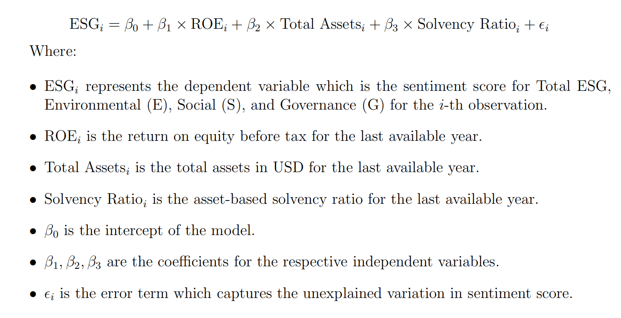
Regression Analysis
Four
Regressions
After gaining esg sentiment score, we try to find the relationship between financial metrics and esg sentiment score, in order to find whether the company are inclined to conceal the bad financial performance using positive esg content or inclined to have positive tone in esg content when financial performance is good. Here is our regression model. If company are trying to conceal, the coefficient of beta are expected to be negative before ROE(higher ROE indicate good profitability performance) and positive before Solvency ratio(low solvency ratio indicate good debt control).

Slide 25
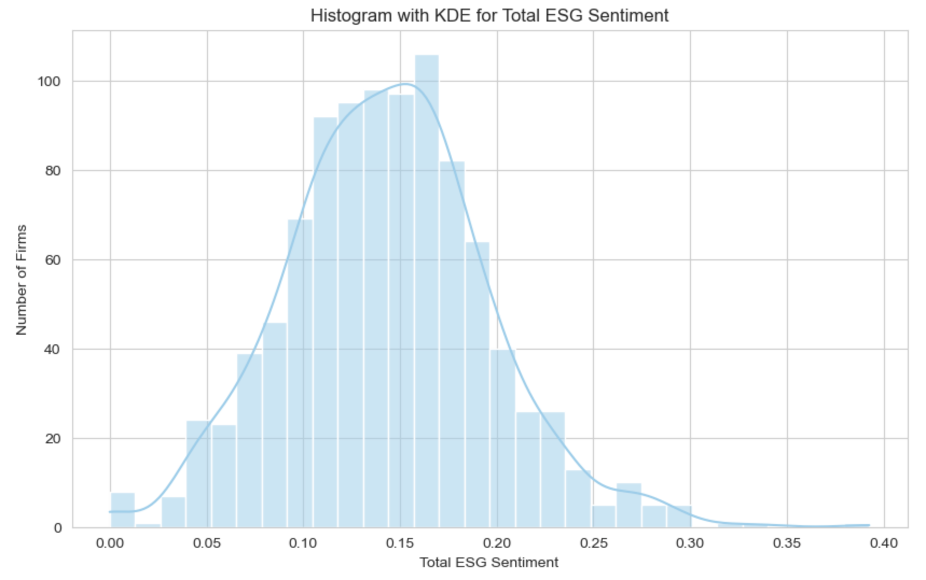
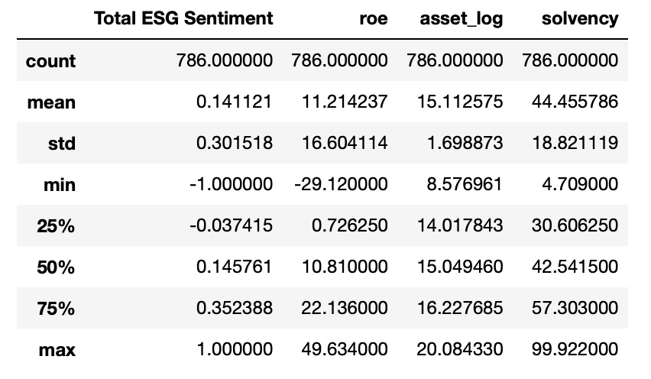
Descriptive Statistics
The total ESG sentiment score are within the range of -1 and +1, with a mean of 0.139. Mean of the esg sentiment of all sample companies is positive, implying that most companies are trying to report positive ESG content, which is within our expectations. But the variation of sentiment is very large for reports.
Distribution of Sentiment
Distribution of Sentiment
Notes:
Mean of the esg sentiment of all sample companies is positive, implying that most companies are trying to report positive ESG content, which is within our expectations. But the variation of sentiment is very large for reports.

Slide 26
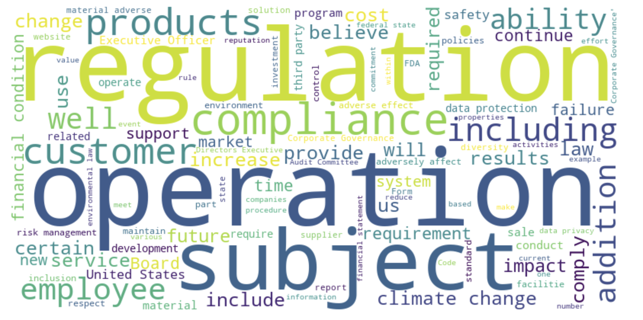
Word Cloud Illustration
We also made wordcloud to illustrate the word frequency of esg content. Words like “regulation”, ”compliance” frequently occurs in the esg content.

Slide 27
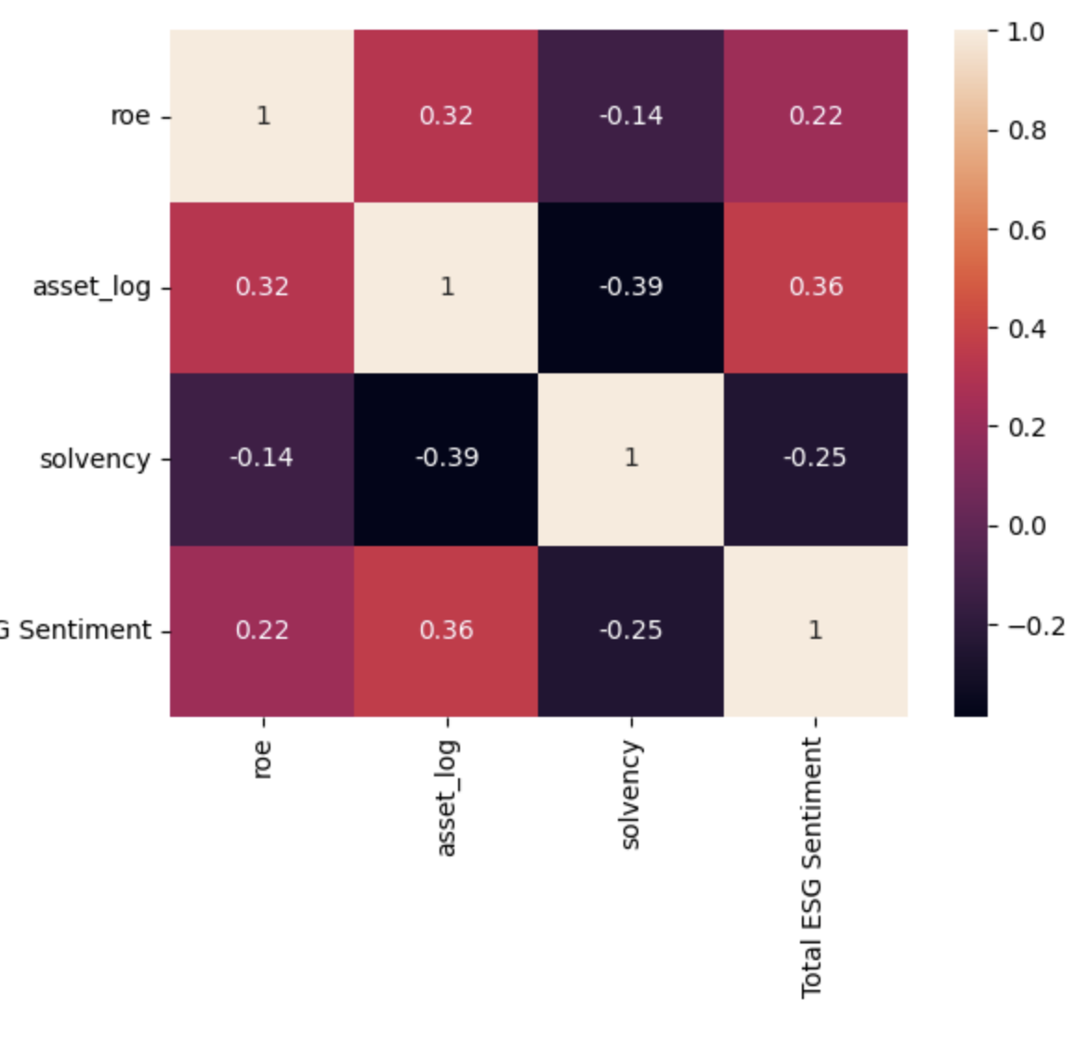
Correlation coefficient Heat map
The heatmap shows that there are certain degree of correlation between total ESG sentiment and financial metrics, and we can get a roughly positive relationship between ROE and total asset and Total ESG sentiment, and roughly negative relationship between solvency ratio and ESG score. But we still cannot conclude the relationship between ESG score and financial metrics. Thus we need to run the regression
Notes:
If we only look roughly look at the correlation coefficient between independent variables, the result seems not that good, there is no evident pattern of positive nor negtive relationship in this scatter plot. When we look at the heatmap, we can get a roughly positive relationship between ROE and Total ESG sentiment. But we still cannot conclude the relationship between esg score and financial metrics. Thus we need to run the regression

Slide 28
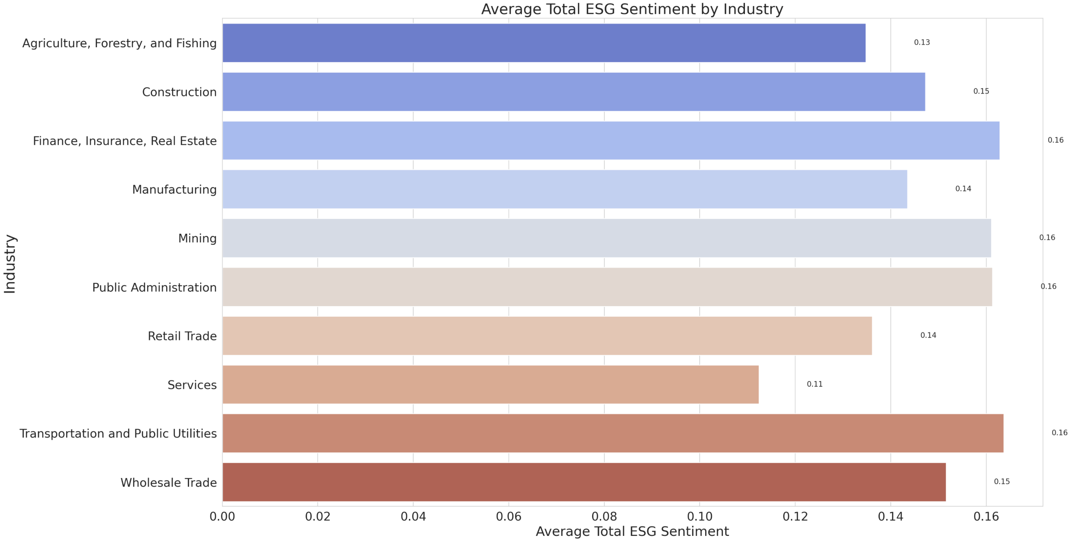
Heterogeneity of ESG score (across industry)
If we try to see the ESG score difference in our sample across industry, what we can see is that firms in manufacturing industry generally have high ESG sentiment score. Firms in service industry has the lowest ESG sentiment score. Since firms in manufacturing industry generally have more potential to interact with environment and may causes conflicts with nearby community if does not handle environmental and social issue well, it is reasonable for us to expect a high ESG score (in other words, a more positive ESG tone to convey that they have take the social responsibility) in manufacture firms.
Notes:
It can be seen that

Slide 29
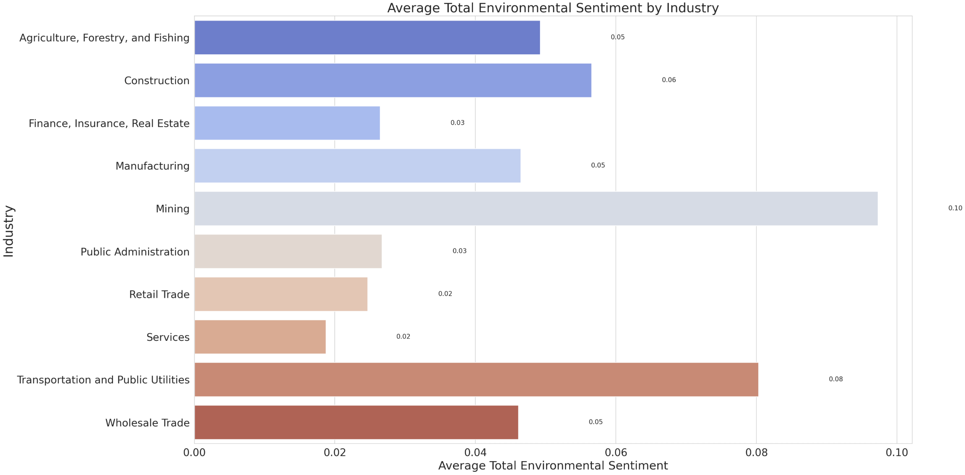
Heterogeneity of E score (across industry)
Positive E(Environmental) action: reduce environmental cost
If we try to see the Environmental score difference in our sample across industry, what we can see is that firms in mining and transportation industry generally have high Environmental sentiment score. Since firms in mining industry generally have more potential to cause negative environmental externalities and may causes conflicts with nearby community if does not handle environmental issue well, it is reasonable for us to expect a positive Environmental sentiment that firms want to convey.
Notes:
It can be seen that

Slide 30
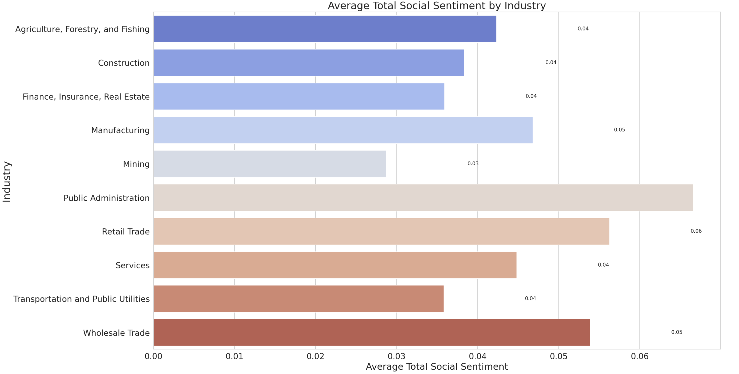
Heterogeneity of S score (across industry)
Positive S(Social) action: consider social Interest
If we try to see the Environmental score difference in our sample across industry, what we can see is that firms in public administration industry generally have high Social sentiment score. Since public administration firms generally have more potential to include social responsibility and social interest in their company mission, it is reasonable for us to expect a positive Social sentiment that firms want to convey.
Notes:
It can be seen that

Slide 31
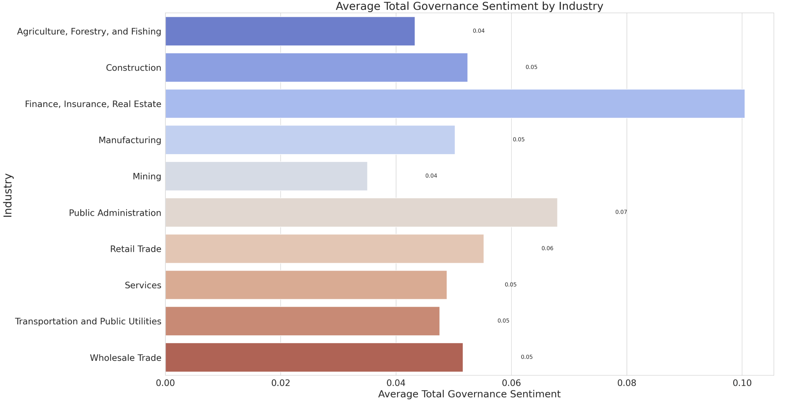
Heterogeneity of G score (across industry)
Positive G(Governance) action: strengthen internal Control
If we try to see the Environmental score difference in our sample across industry, what we can see is that firms in finance industry generally have high Social sentiment score. Since stakeholders of finance firms generally have more caring in the usage of funds and internal control issue, it is reasonable for us to expect a positive Governance sentiment that firms want to convey.
Notes:
It can be seen that

Slide 32
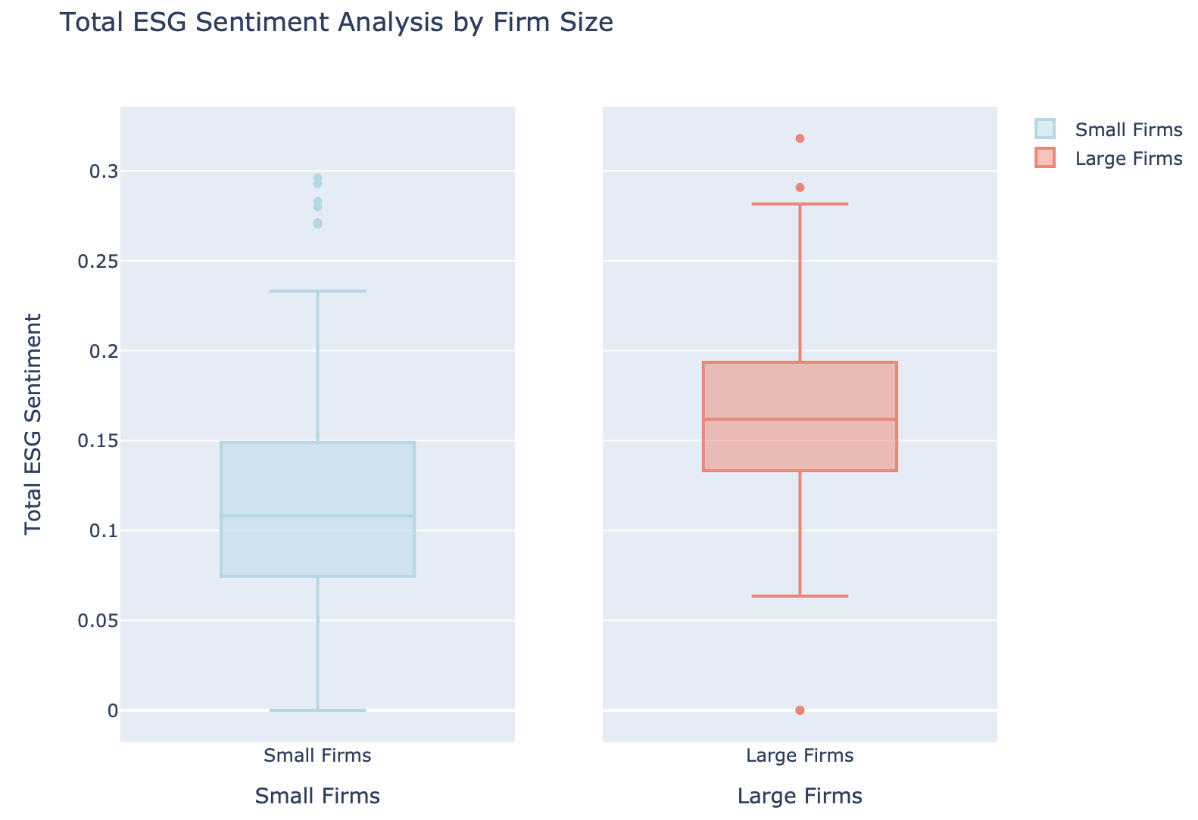
Heterogeneity of ESG score (for different Firm Size)
If we try to compare the ESG score of small and large firms (below average total asset and the rest), what we can see is that small firm generally have lower ESG score, while large firm generally have larger ESG score. Large company may consider more of its social influence and tend to have more positive tone when conveying ESG content.
Notes:
It can be seen that

Slide 33
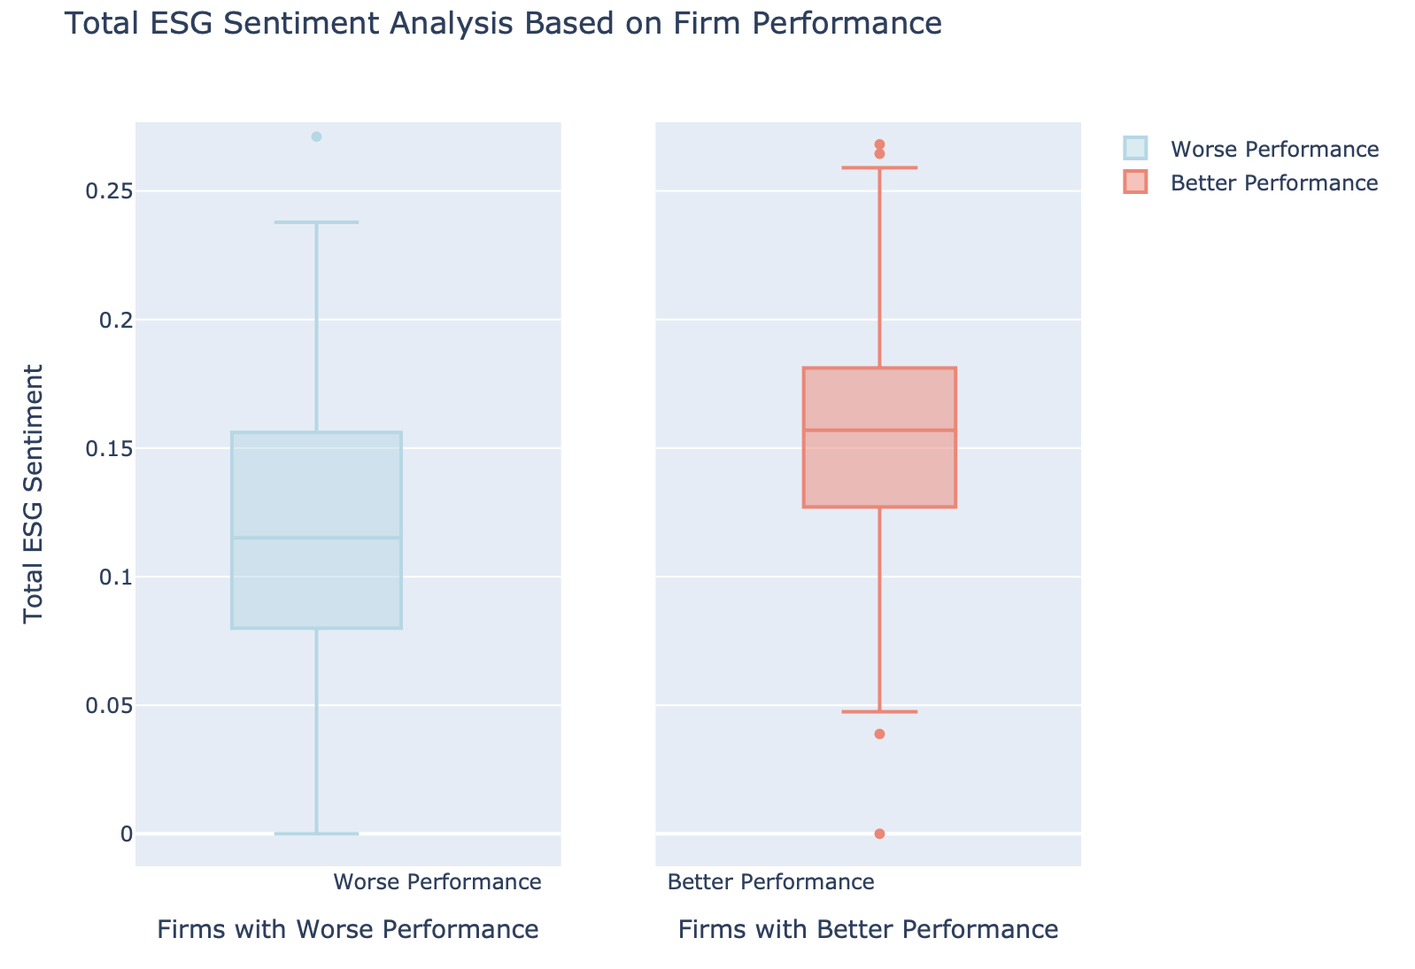
Heterogeneity of ESG score (for different Firm profit performance)
If we try to compare the ESG score of better and worse performance firm(firm with above average ROE and the rest), what we can see is that firm with better performance generally have higher ESG score. It gives us a sense that firms are likely to have consistent sentimental expression in ESG report with their overall firm performance.
Notes:
It can be seen that

Slide 34
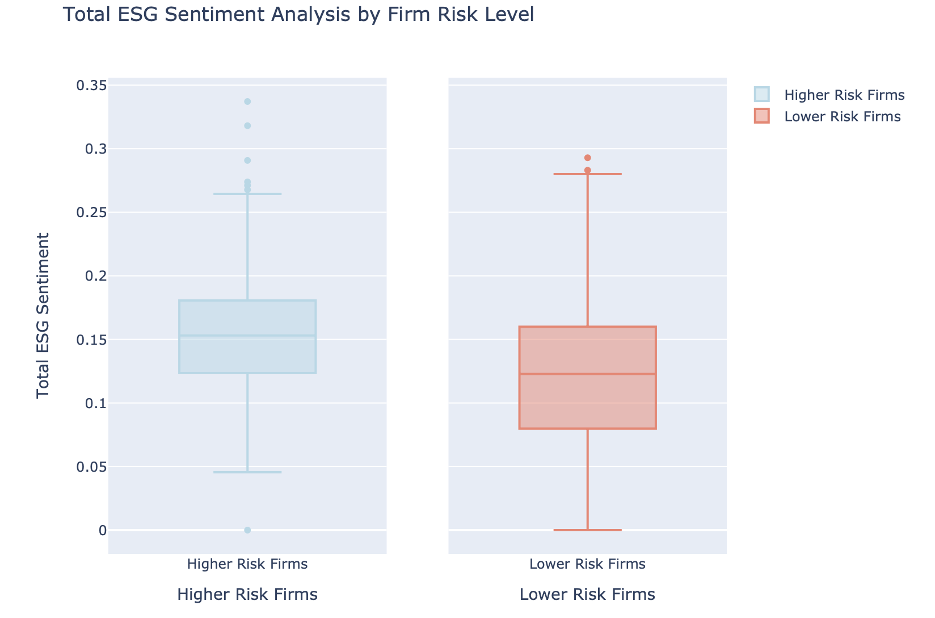
Heterogeneity of ESG score (for different debt risk)
If we try to compare the ESG score of firm with different debt risk (above average solvency ratio and the rest), what we can see is that firm with higher debt risk generally have higher ESG score, indicating the firm may utilize the ESG content to prettify its report.
Notes:
It can be seen that

Slide 35
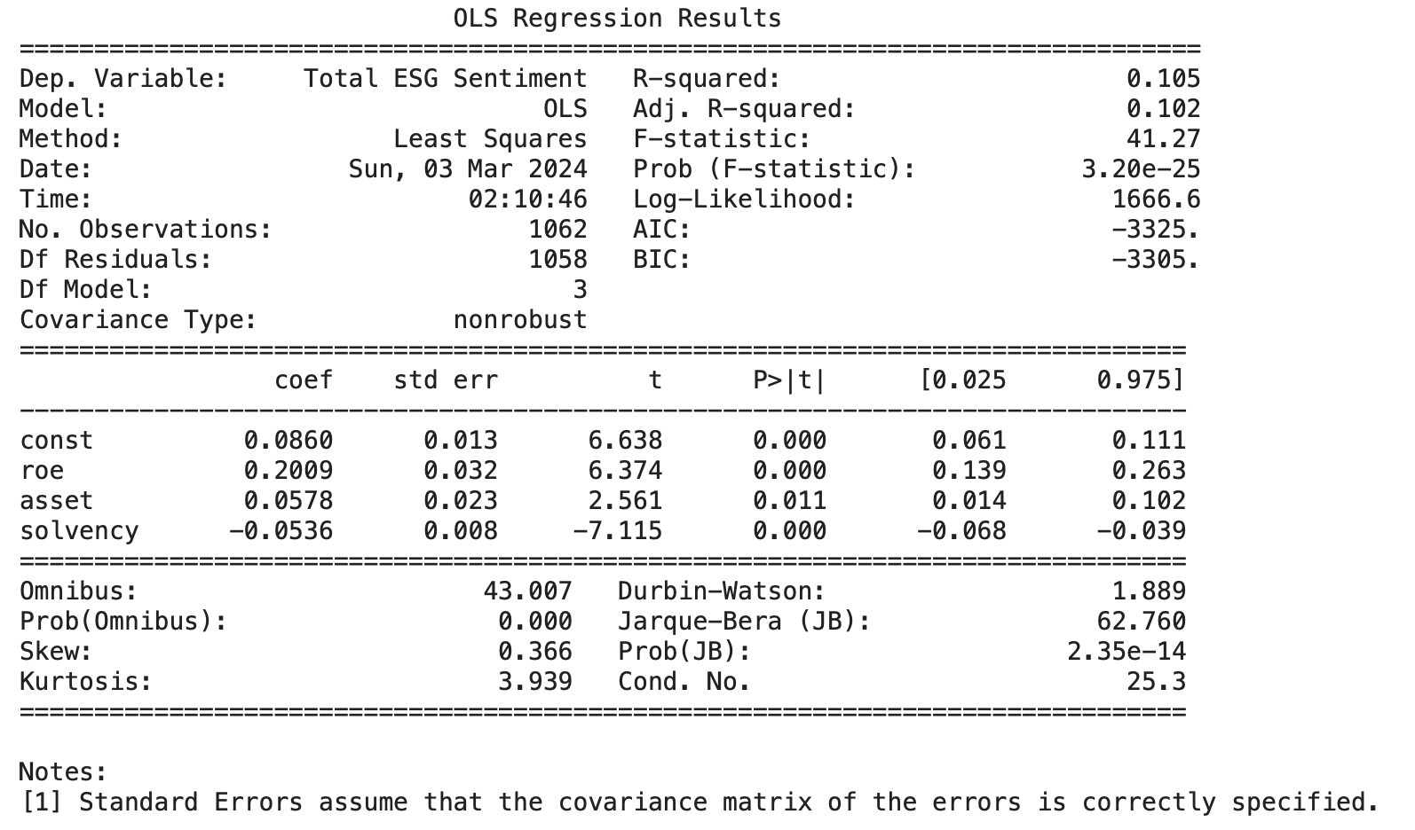
Regression Results - I
Y: Total ESG Sentiment
The regression of total ESG score on ROE shows a positive relationship, and the positive coefficient is statically significant at 1%. Profitability performance is positive correlated with the degree of positivity of ESG tone. Thus we can conclude that the company are generally not inclined to conceal the bad financial performance using positive ESG content. If the overall financial performance is good, companies tend to report financial performance in a more positive tone.
As the total ESG score is significantly significant, we want to inspect the relationship between each component of ESG score and financial metrics, to see if company have any inclination to use specific E, S or G related narrative to prettify its financial report.
Notes:
The regression of total ESG score on return on equity shows a positive relationship, and the positive coefficient is statically significant. Thus we can conclude that the company are generally not inclined to conceal the bad financial performance using positive ESG content. If the overall financial performance is good, companies tend to report financial performance in a more positive tone.

Slide 36
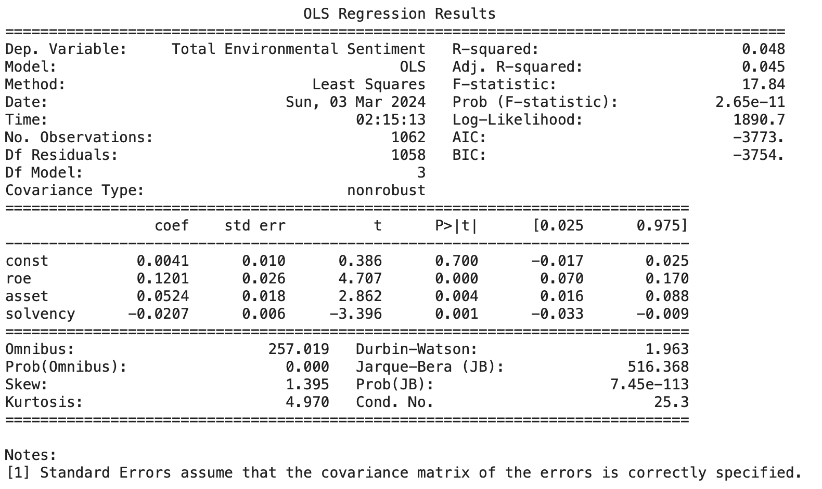
Regression Results - II
Y: Total E Sentiment
Adj. Rsquared: 5% Coefficients: coefficient of ROE and solvency ratio is significant at the 1% level
Then we separately run reg on Environment, Social and Governance score, to show if company have incentive to manipulating words in separate category to conceal the bad performance. Overall, if the overall financial performance is good, companies tend to report environmental responsibility performance in a more positive tone. For Environmental score, the beta coefficient of ROE is significantly positive at 1%, the beta coefficient of Solvency ratio are significantly negative at 1%, as high ROE and low solvency ratio is a positive indicator of firm performance, the corresponding positive and negative beta shows that shows that firm’s good performance is positively correlated with social responsibility disclosure, implying that firm are not using tone of Environmental content to prettify its report.
Notes:
The regression of total ESG score on return on equity shows a positive relationship, and the positive coefficient is statically significant. Thus we can conclude that the company are generally not inclined to conceal the bad financial performance using positive ESG content. If the overall financial performance is good, companies tend to report financial performance in a more positive tone.

Slide 37
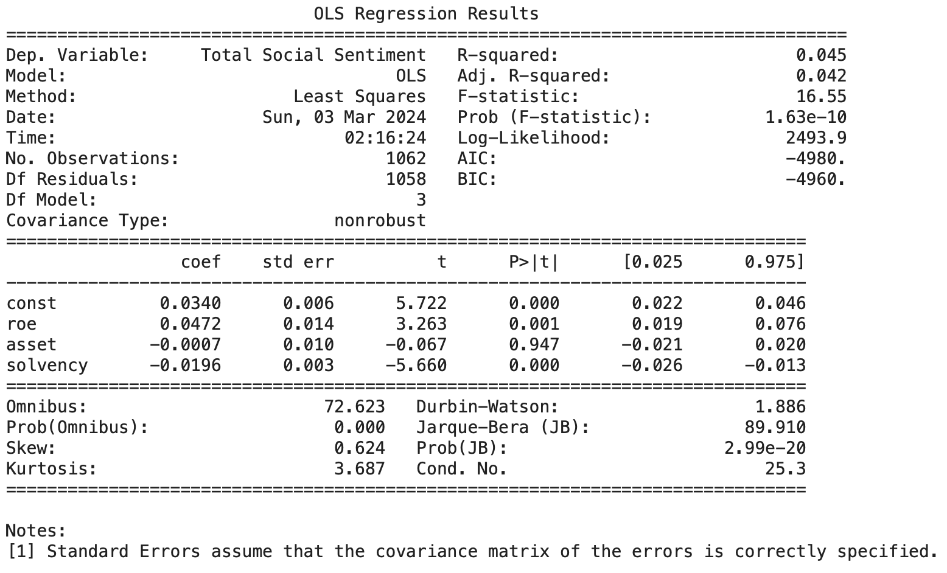
Regression Results - III
Y: Total SSentiment
Adj. Rsquared: 5%; Coefficients: coefficient of ROE and solvency ratio is significant at the 1% level
For Social score, the beta coefficient of ROE is significantly positive at 1%, the beta coefficient of Solvency ratio are significantly negative at 1%, as high ROE and low solvency ratio is a positive indicator of firm performance, the corresponding positive and negative beta shows that firm’s good performance is positively correlated with social responsibility disclosure, implying that firm are not using positive tone of Social responsibility content to prettify its report.
Notes:
The regression of total ESG score on return on equity shows a positive relationship, and the positive coefficient is statically significant. Thus we can conclude that the company are generally not inclined to conceal the bad financial performance using positive ESG content. If the overall financial performance is good, companies tend to report financial performance in a more positive tone.

Slide 38
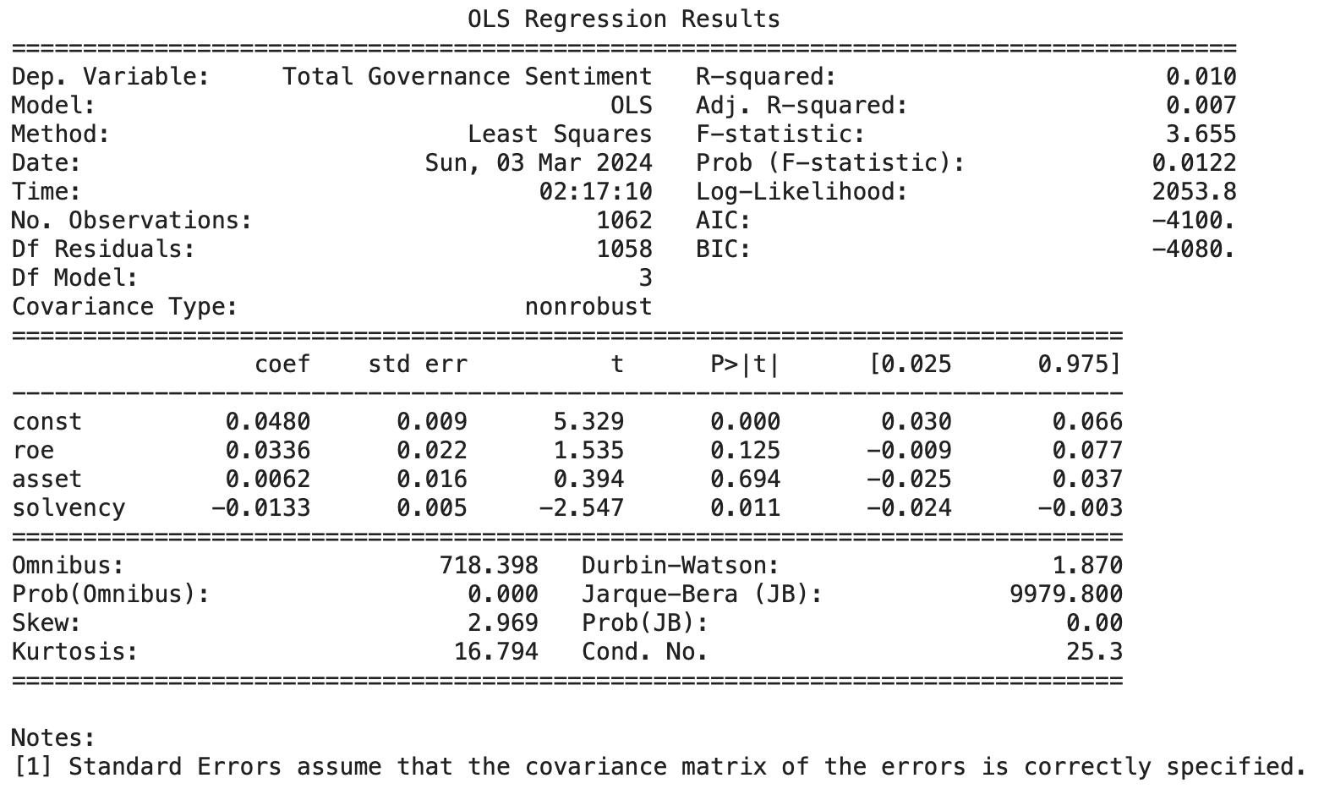
Regression Results - IV
Y: Total G Sentiment
Adj. Rsquared: 1%; Coefficients: coefficient of ROE is not significant and coefficient of the solvency ratio is significant at the 5% level
For Social score, the beta coefficient of Solvency ratio are significantly negative at 1%, as low solvency ratio is a positive indicator of firm performance, the corresponding negative beta shows that firm’s good performance is positively correlated with social responsibility disclosure, implying that firm are not using positive tone of Governance responsibility content to prettify its report. Notice that here the coefficient of ROE is positive but not significant, and the coefficient of ROE is lower than that in regression II and III, which means that tone of governance component may have least relationship with firm’s financial status.
Notes:
The regression of total ESG score on return on equity shows a positive relationship, and the positive coefficient is statically significant. Thus we can conclude that the company are generally not inclined to conceal the bad financial performance using positive ESG content. If the overall financial performance is good, companies tend to report financial performance in a more positive tone.

Slide 39
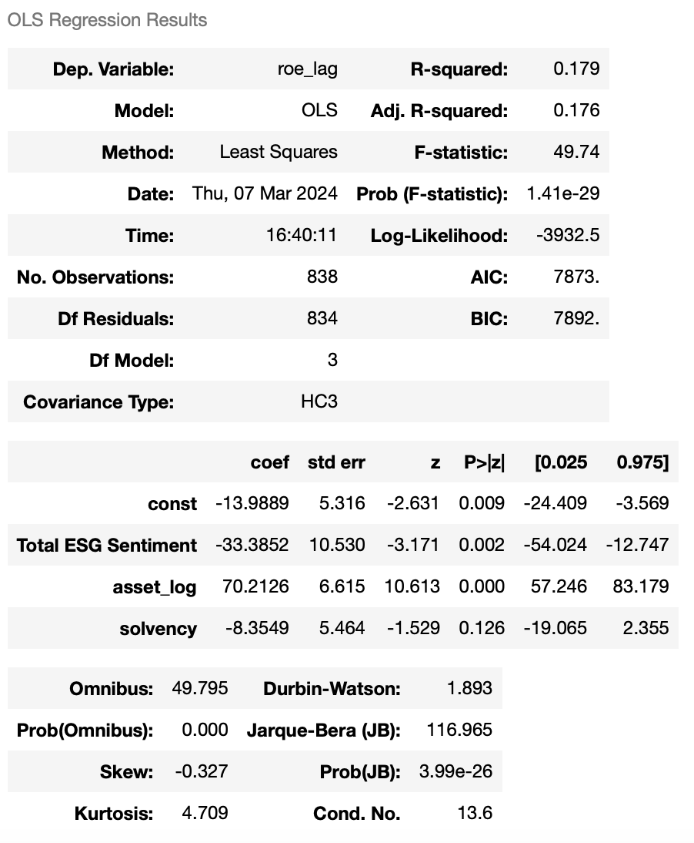
Regression Results - V
Y:ROE
Adj. Rsquared: 1%; Coefficients: coefficient of ROE is negatively significant and coefficient of the solvency ratio is significant at the 5% level
When we try to explore the relationship between ESG sentiment and investor confidence, we try to find whether the the ESG sentiment in current year report may have some impact on the next year financial performance of the company. We expect that the company’s good esg tone may impact investor’s confidence to invest in this company, and with the inflex of capital, the company may have better financial performance.
However, what we finally find is that the relationship between ESG sentiment and ROE is negative and significant at 5%, this may imply that the investors may responed negatively to positive ESG tone, as they may think positive esg tone may raise their concern towards the company’s performance.

Slide 40
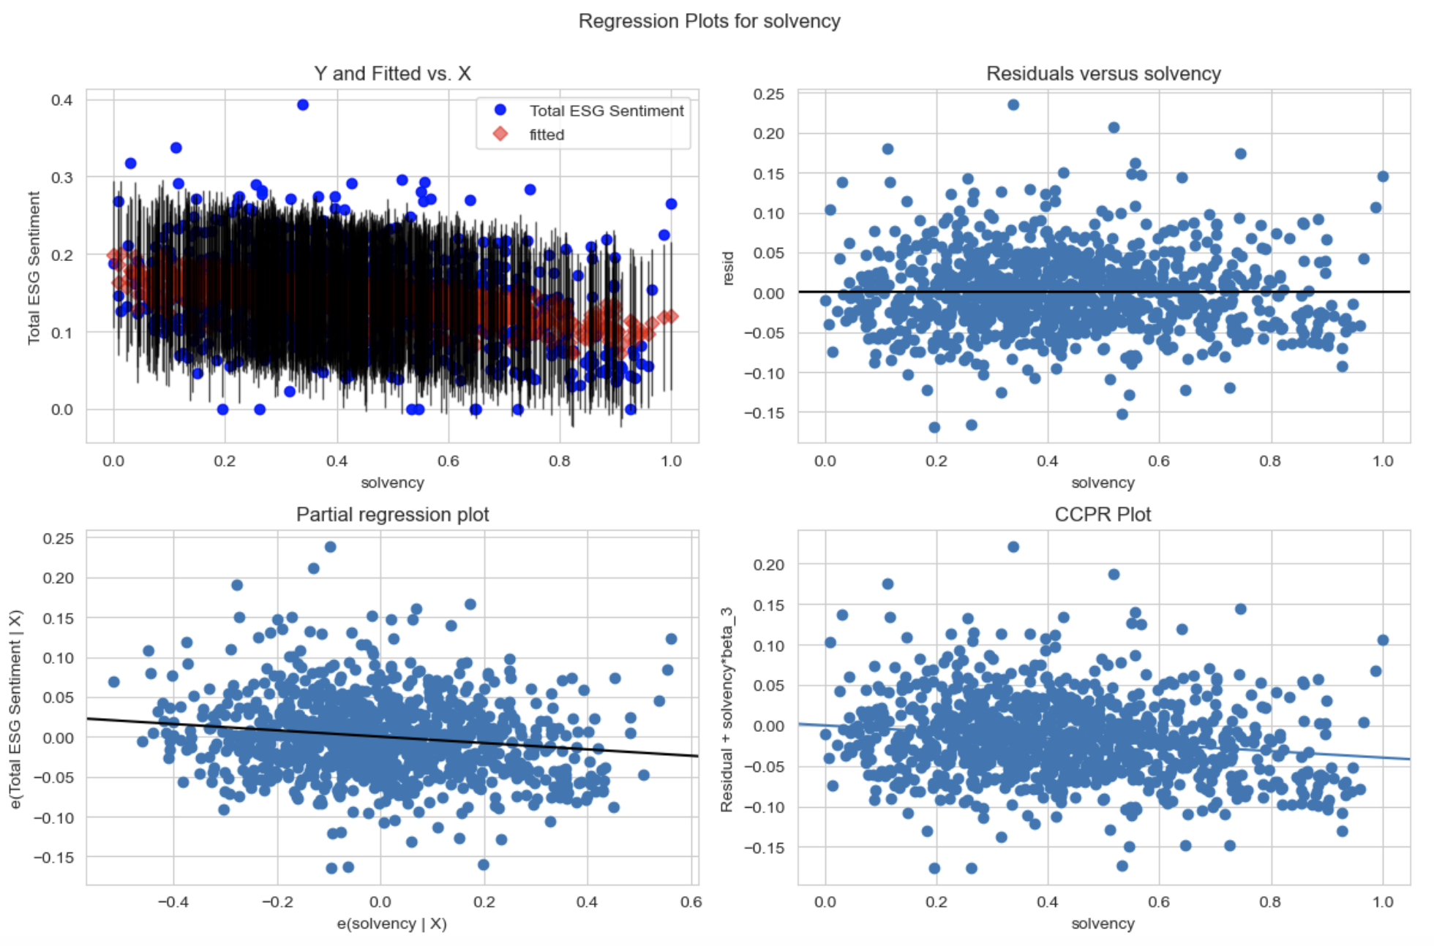
Residual Analysis
We can see from the regression plot and residual analysis plot that there is still some outliers in our graphs, which may require us to further process our data.
Notes:
还有outlier，回归还有问题，后面会进一步处理 We can see from the regression plot and residual analysis plot that there is still some outliers in our graphs, which may require us to further process our data.

Slide 41
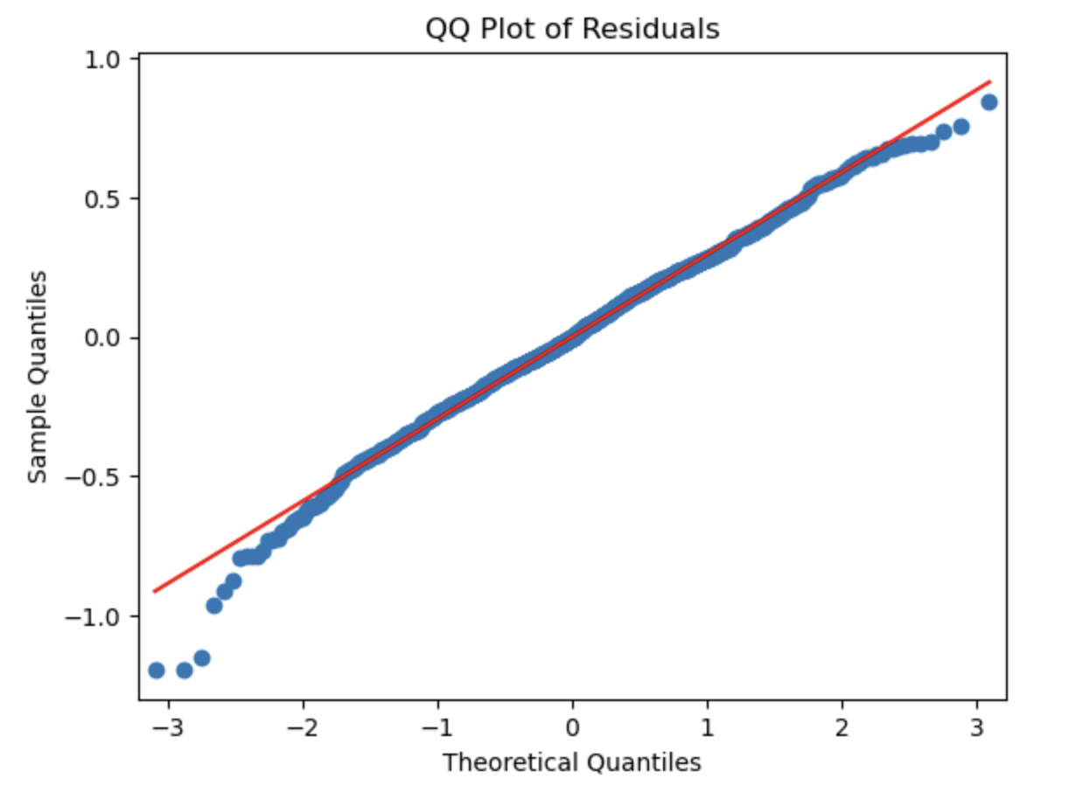
QQ Plot of Residuals
The residual analysis shows that the normality assumption of estimator did not break.
Notes:
残差分析结果：OLS estimator assumption没有break，OLS estimator可信 The residual analysis shows that the normality assumption of estimator did not break.

Slide 42
THANK YOU
Q&A

